Slide 1
Misc. reading related to rotor position estimation
Sep 29, 2016

Slide 2
Reference
Rotor position estimation:
[1] J. Holtz and J. , “Sensorless vector control of induction motors at very low speed using a nonlinear inverter model and parameter identification, ” IEEE Trans. on Industrial Applications, vol. 38, pp. 1087-1095, 2002.
No extra injection signal
[2] Lee et al., “Sensorless control of surface0mount permananet-magnet synchronous motors based on a nonlinear observer,” IEEE Trans. On Power Electronics, vol. 25, pp. 290-296, 2010.
Injected signal: DC voltage trains
Winding function:
[3] Jov

Slide 3
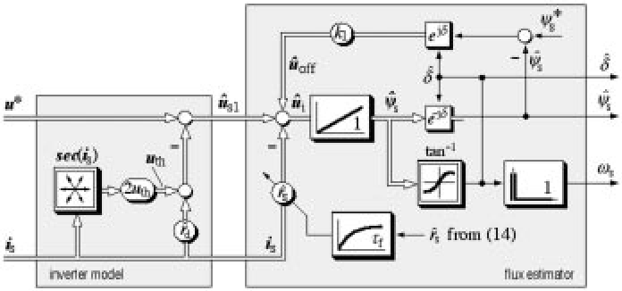
Holtz 02’: sensorless ctrl. for induction machine
Consider nonlinearity in power electronics
The paper does not use the measured stator voltage, but the reference voltage with some tweaking to estimate stator flux
Stator flux estimation:
Based on a pure integrator
Special treatments to deal with offset
Inverter model:
Dead time compensation
Parameter ID:
Voltage threshold (off-line)
Stator resistance (on-line)

Slide 4
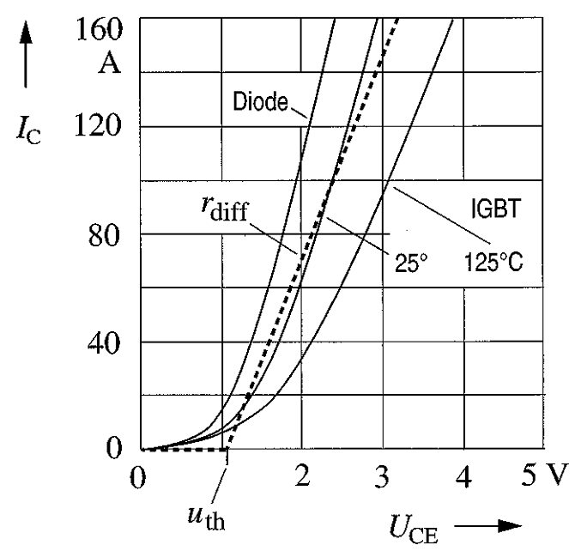

Invertor model
Non-ideal stator voltage due to nonlinearity of power electronics:
$${\hat{u}}_{s}=u^{∗}−u_{th}−r_{s}i_{s}$$
Ref. volt.
Switching of IGBT cannot be infinitely fast
Stator resistance varies with temperature (variation can be as large as 30%)

Slide 5


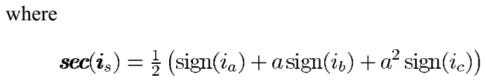
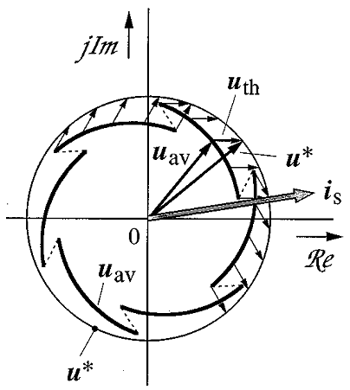
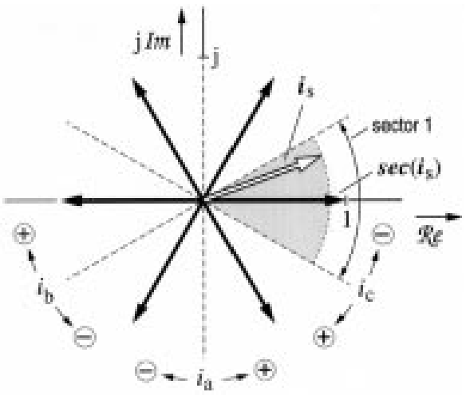
Offline ID of u_{th}
=>

Slide 6
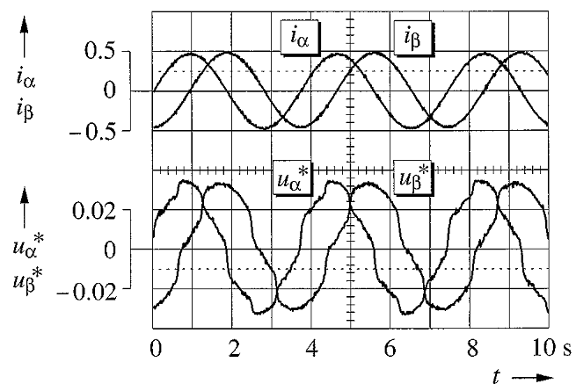
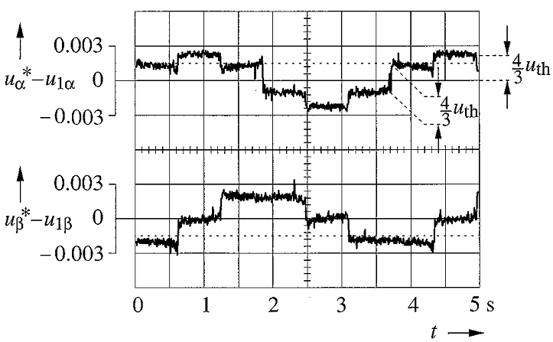
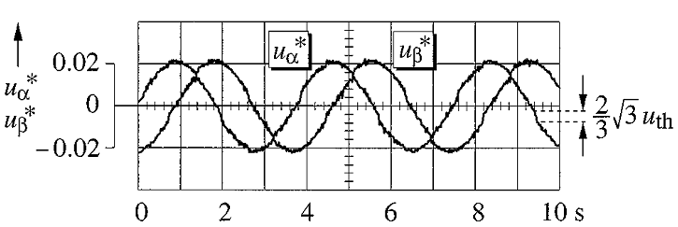
Offline ID of u_{th}
u_{th} is more significant in low-speed operation
After dead time compensation
After filtering out the fundamental component

Slide 7
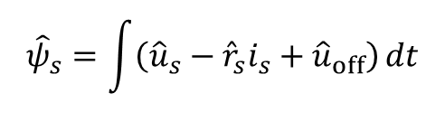

Stator flux estimation
Ideal stator voltage equation:
$$u_{s}=r_{s}i_{s}+\frac{dψ_{s}}{dt}$$
Non-ideal stator flux estimation: (u_{off} represents all errors in measurement, such as offsets)
$${\hat{ψ}}_{s}=\int{\left({\hat{u}}_{s}−{\hat{r}}_{s}i_{s}+{\hat{u}}_{off}\right)}dt$$
From the invertor model with dead-time compensation & off-line ID of u_{th}
To be identified online

Slide 8



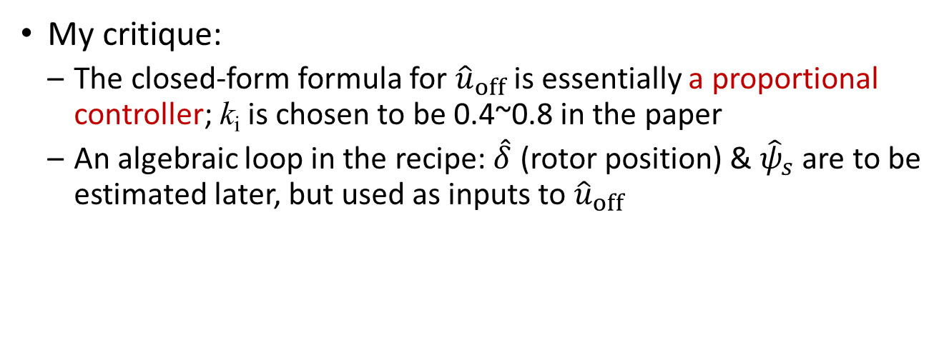

Online ID of ${\hat{u}}_{off}$
and
My critique:
The closed-form formula for ${\hat{u}}_{off}$ is essentially a proportional controller; k_{i} is chosen to be 0.4~0.8 in the paper
An algebraic loop in the recipe: $\hat{δ}$ (rotor position) & ${\hat{ψ}}_{s}$ are to be estimated later, but used as inputs to ${\hat{u}}_{off}$

Slide 9
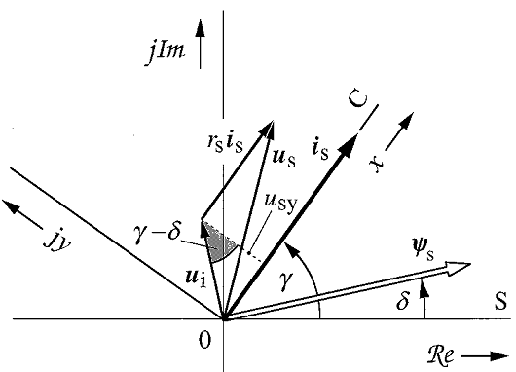






Online ID of ${\hat{r}}_{s}$
$$u_{s}=r_{s}i_{s}+\frac{dψ_{s}}{dt}$$
Ideal stator voltage equation:
=> $ψ_{s}$ and $u_{i}$ (induced voltage) are orthogonal
=> The geometric relationship: $r_{s}i_{sx}=u_{sx}−u_{sy}\tan\left(γ−δ\right)$
Furthermore, with:
=>

Slide 10


Holtz 02’: sensorless ctrl. for induction machine
Online estimated via a P-controller based on $ψ_{s}$ discrepancy
Offline ID via FFT
Geometrical relationship that $ψ_{s}$ and $u_{i}$ are orthogonal

Slide 11
LEE 10’: nonlinear observer for SMPM motors
Uses an interesting state in the observer
No need to estimate rotor speed
Zero-speed is not observable; for speed >10rpm (0.01 p.u.)

